Slide 1
CSS
MCNDHS
Ms. Eng

Slide 2
aim: what Is the nth-child selector?
Do now:
Daily Grade:
On-time/attendance/not leaving the classroom: 25%
Cellphones: 25%
Notes:25%
Classwork/Homework: 25%

Slide 3
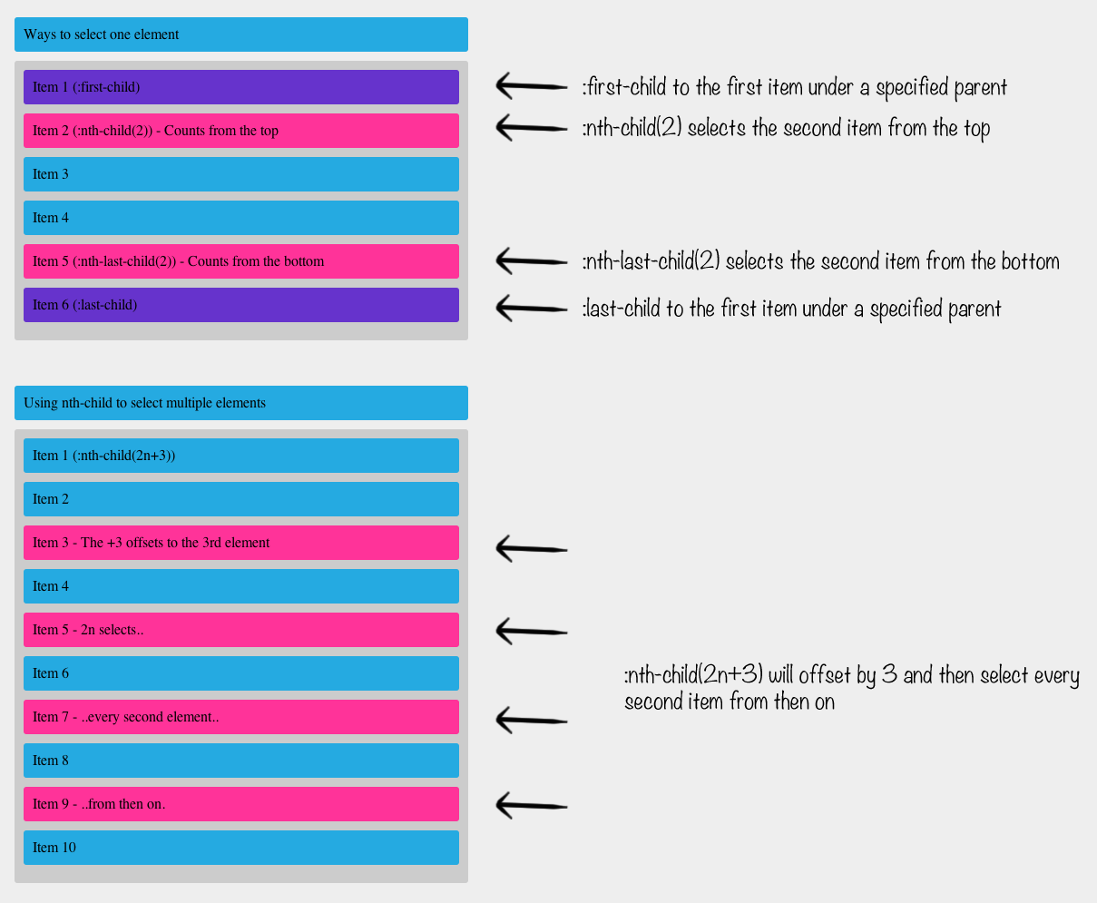
what are we learning today:

Slide 4
nth-child options: factors of 3
element: nth-child(3n){
}
why?

Slide 5
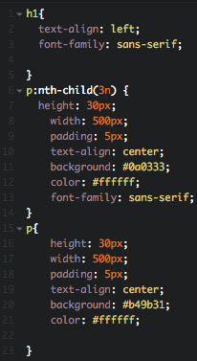
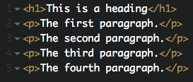
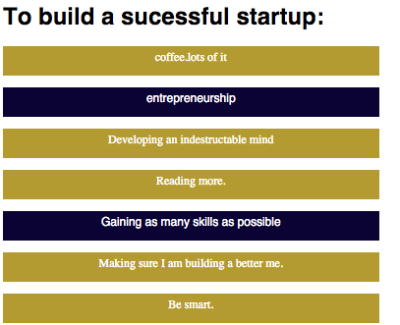
example:

Slide 6


activity
to get credit:
for extra credit:

